Slide 1
METU · PHYSICS 400 FINAL PRESENTATION
Holographic Spectral Alignment
Recovering 3-D orientation from boundary information
Eren Erberk Erkul
Advisor Murat Temiz
Middle East Technical University, Ankara
Thursday, 11 June 2026
Notes:
(~0:20) Title. Greet committee. Joint work with Murat Temiz at METU. State: a deterministic, physics-inspired method for 3-D orientation. Remember to remind the advisor of the session info beforehand.

Slide 2
The problem: 3-D orientation
Recover the rotation R ∈ SO(3)
that aligns an observed object to a reference
Robotics & pose
Molecular reconstruction
Computer vision
band-limited data on the sphere
Notes:
(~0:50) Orientation estimation is an inverse problem. Reveal the three domains (click): robotics, cryo-EM / molecular reconstruction, vision. Common setting: band-limited data on a sphere. Goal is the rotation R in SO(3).

Slide 3
Global vs. fast — the gap
Volumetric
Local methods
✓ global & reliable
✓ cheap per step
✗ O(L⁴) — costly
✗ needs init · local minima
We want: deterministic · global · fast
Notes:
(~0:50) Two camps. Full rotation-group correlation: globally reliable but O(L^4). Local methods like ICP: cheap but need good initialization and stick in local minima (reveal). The gap we target (reveal): deterministic, global, and fast at once.

Slide 4
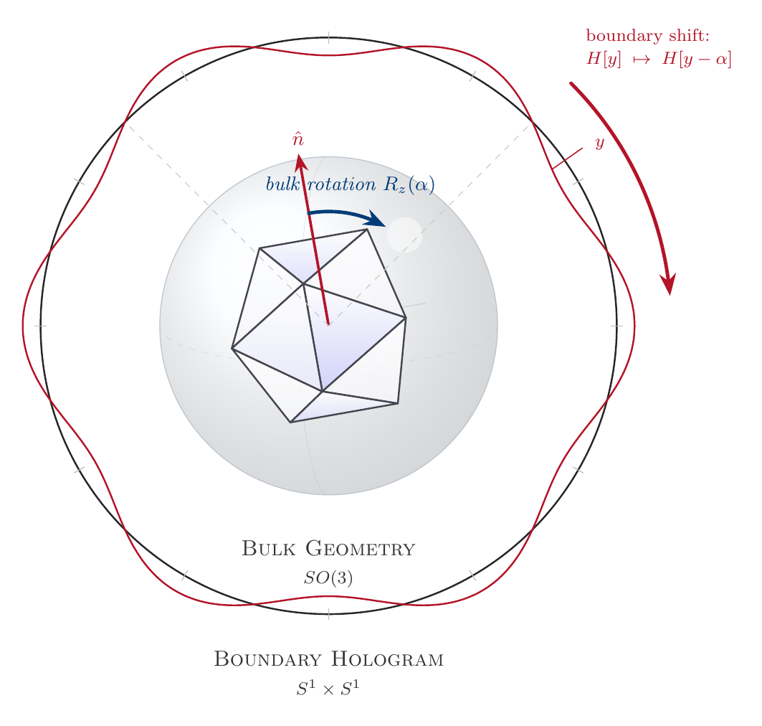
A holographic viewpoint
Bulk: SO(3)
Boundary: a 1-D hologram
Rotation ⟷ shift
Notes:
(~1:10) Core idea, borrowed from the holographic principle ('t Hooft, Susskind): encode a higher-dimensional problem on a lower-dimensional boundary. Reveal: the bulk is SO(3); the boundary is a 1-D hologram; a bulk rotation R_z(alpha) becomes a rigid shift of the hologram. Point to the figure.

Slide 5
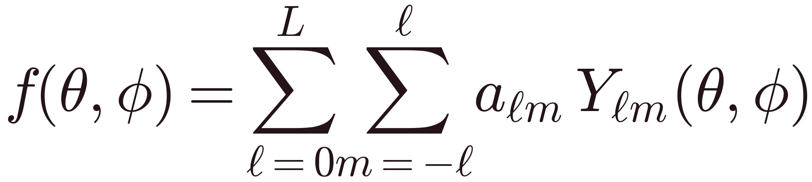
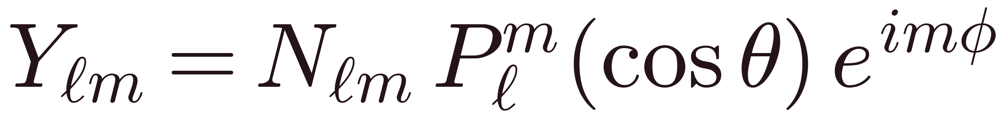
Spherical harmonics: Fourier on a sphere
Expand band-limited data
A wrapped Fourier mode
ℓ — angular frequency m — azimuthal order
Notes:
(~1:00) Represent the object as a function on the sphere, expanded in spherical harmonics to band-limit L. Reveal: Y factorizes into a Legendre polar part times an azimuthal Fourier mode e^{i m phi}. ell is total angular frequency; m is the azimuthal order. That azimuthal factor is the lever we pull.

Slide 6
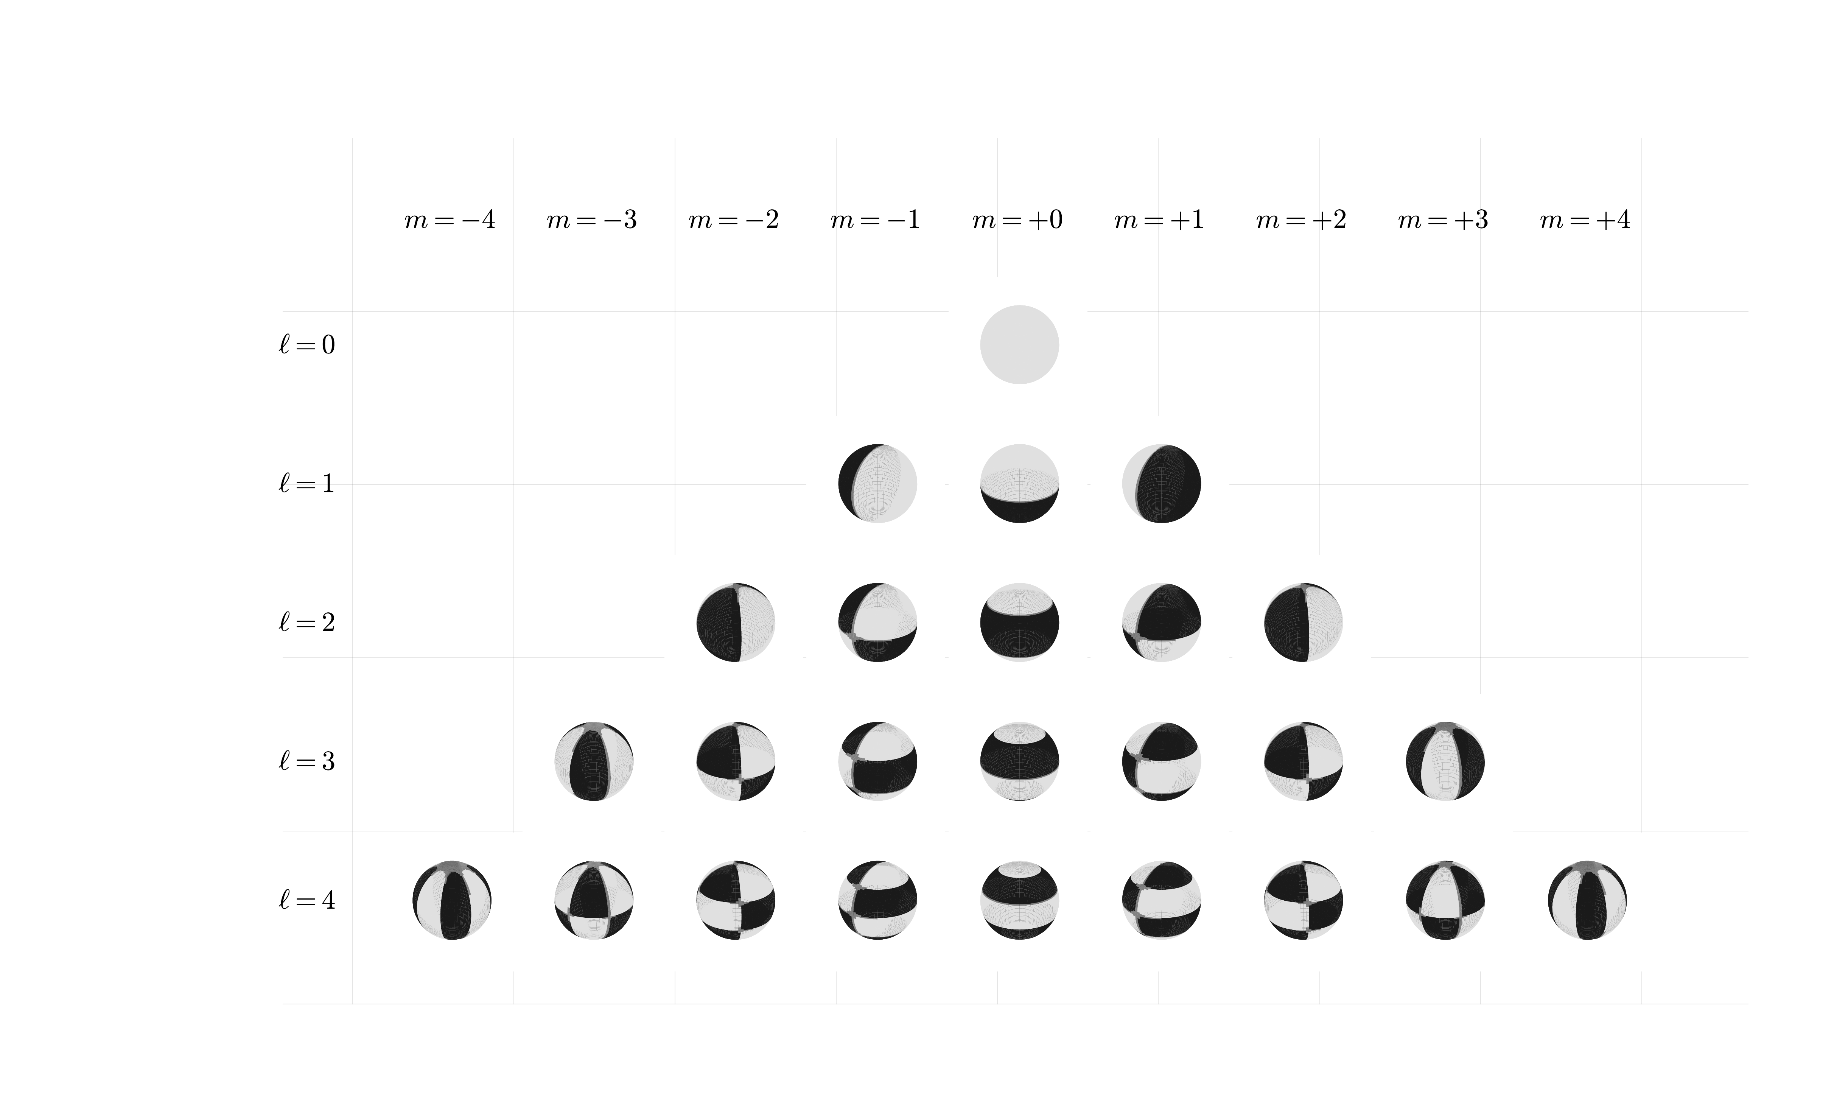
Reading the nodal patterns
m → east–west lines ℓ−|m| → north–south circles high |m| hugs the equator
Notes:
(~0:50) The (ell,m) grid. Reveal: m sets east-west nodal lines; ell-|m| sets north-south circles. Key point for us: the highest |m| modes are squashed onto the equator, so they are exactly what a boundary hologram captures best.

Slide 7
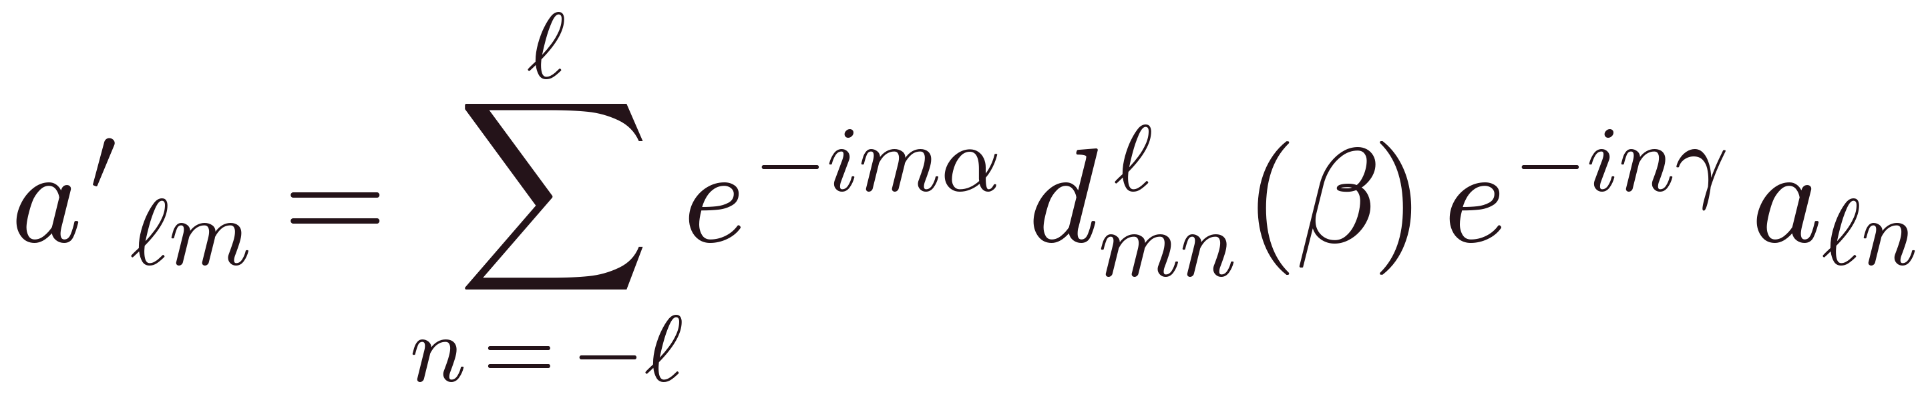
How rotations act
Notes:
(~1:20) Under Euler z-y-z, coefficients transform by the Wigner-D matrix. Reveal: in operator form the azimuthal rotations alpha, gamma are diagonal phase matrices E and F; the only inter-m mixing is the reduced matrix d(beta). Reveal: at beta=0, d is the identity, so readout is exact. Small beta = phase-dominance regime.

Slide 8
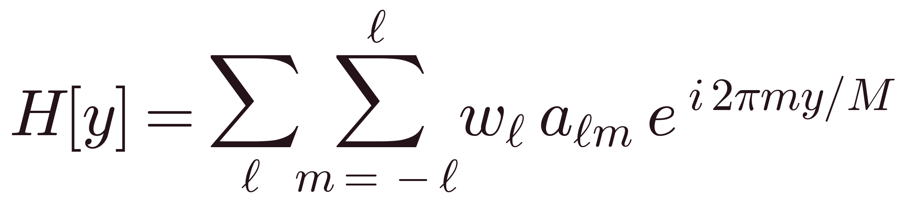
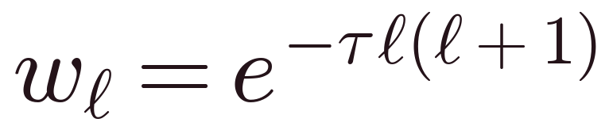
The Holographic Expression
heat-kernel taper — damps high ℓ

Slide 9
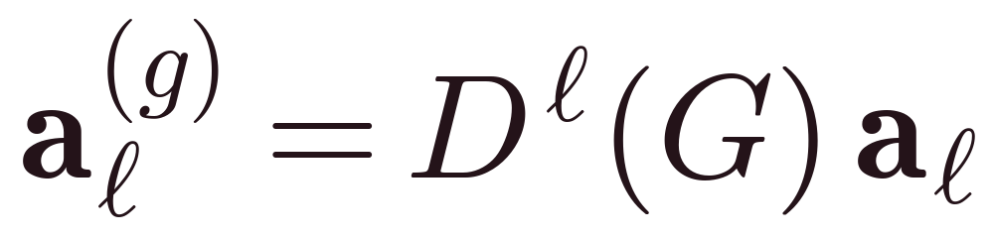
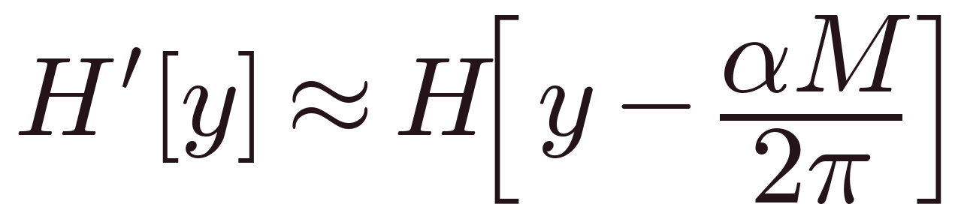
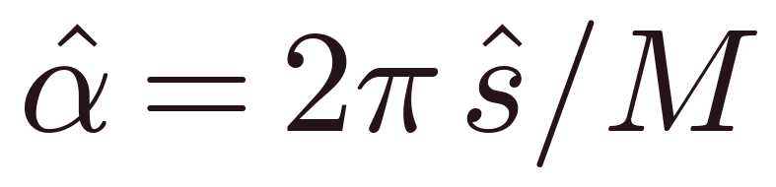
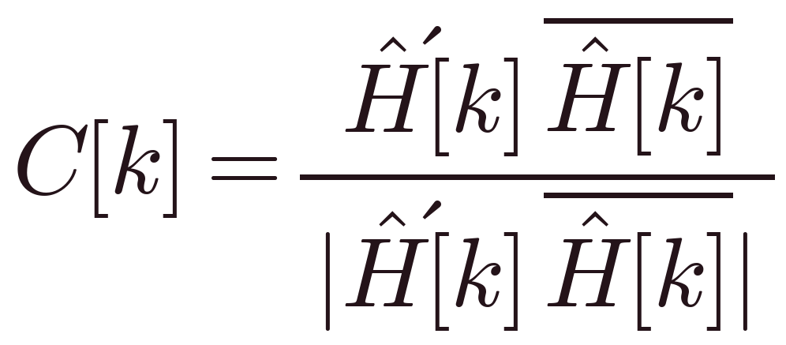
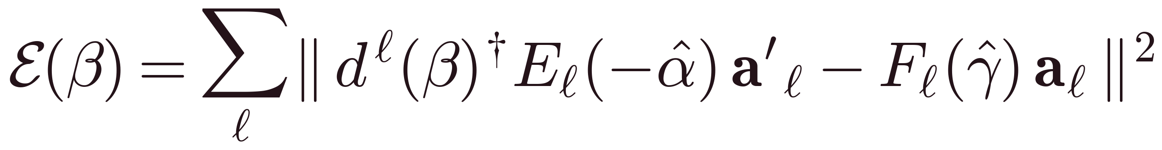
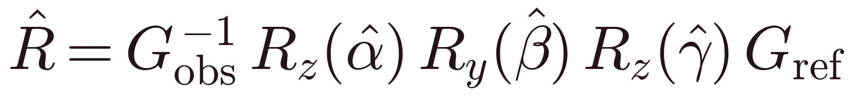
Algorithm
1 · Gauge
quadrupole — β small
2 · Holography
boundary hologram H[y]
3 · Rotation → shift
Fourier shift on the boundary
4 · Read α
FFT phase correlation
5 · Polar search
1-D in β, γ per trial
golden-section over β
6 · Compose R
undo the gauge
Notes:
(~1:20) Because azimuthal rotation is a phase ramp, projecting onto a 1-D complex boundary sequence turns the rotation into a rigid shift. Reveal: recover alpha and gamma by FFT phase correlation - fast and deterministic. Reveal: the remaining polar angle beta is a cheap 1-D search; our quadrupole principal-axis gauge keeps beta small so we stay in the exact regime.

Slide 10
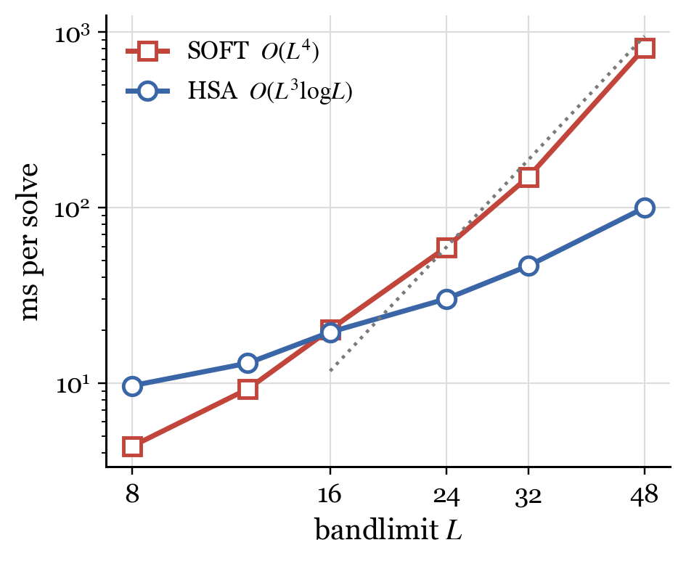
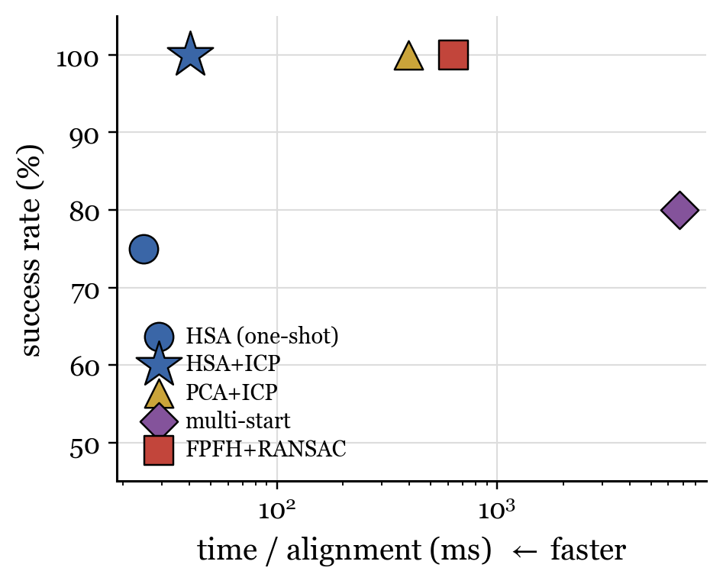
Numerical results
Faster — 8× at L = 48
Fast & reliable vs. FPFH

Slide 11
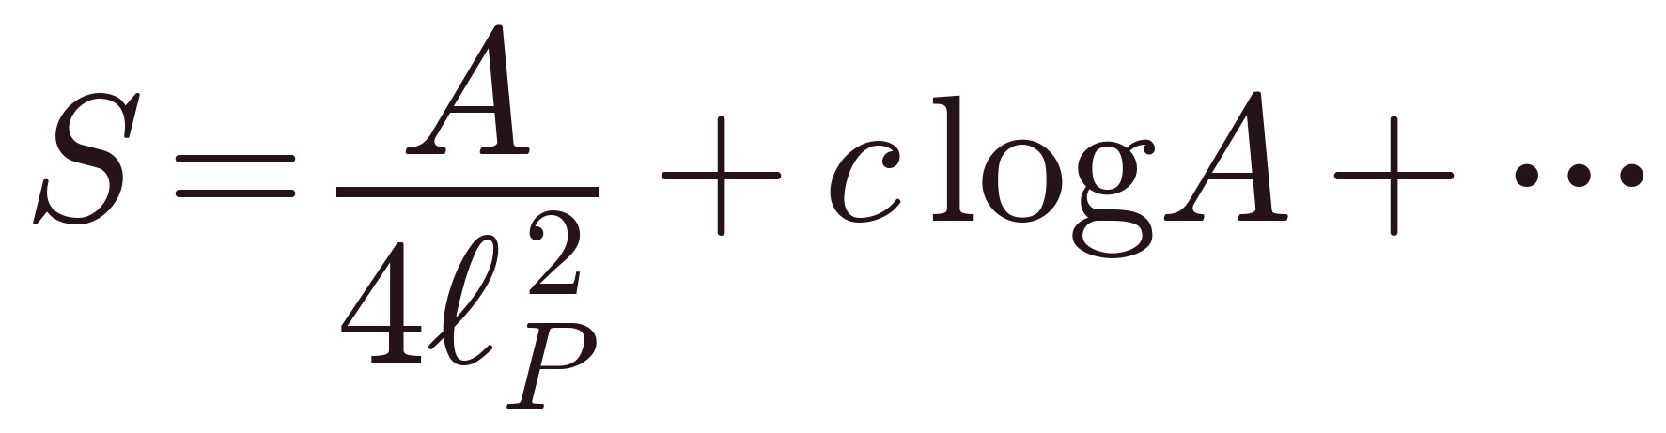
A Reciprocal Prediction
a log-area correction to the Bekenstein–Hawking law
Notes:
(~1:00) The bulk holds ~ (L+1)^2 coefficients; the boundary hologram is a line of length 2L+1. Reveal M = 2L+1. Reveal the loss law: the boundary retains the rotation Fisher information at a fraction ~ 4/L of the bulk - a closed form from a per-isotype Cauchy-Schwarz argument. Lossy, but provably enough to fix the orientation.

Slide 12

TAKE-HOME
3-D bulk ⟷ 1-D hologram
Deterministic · global · no initialization
Notes:
(~0:40) Take-home: a 3-D orientation problem encoded on a 1-D boundary hologram, where rotation is a shift recovered by FFT. Deterministic, global, and cheaper - O(L^3 log L). One sentence each on the reveals, then invite questions.

Slide 13
References
1. Kostelec & Rockmore — FFTs on the rotation group · J. Fourier Anal. Appl. (2008)
2. Driscoll & Healy — FFTs & convolutions on the 2-sphere · Adv. Appl. Math. (1994)
3. Kovacs & Wriggers — Fast rotational matching · Acta Cryst. D (2002)
4. Kuglin & Hines — The phase-correlation image-alignment method (1975)
5. Horn — Extended Gaussian images · Proc. IEEE (1984)
6. ’t Hooft (1993) · Susskind (1995) — the holographic principle
7. Cover & Thomas — Elements of Information Theory, 2nd ed. (2006)

Slide 14
Thank you
Any Questions?
Eren Erberk Erkul · Advisor: Murat Temiz
Middle East Technical University · Physics 400

